Slide 1
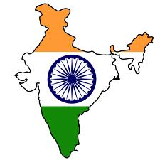
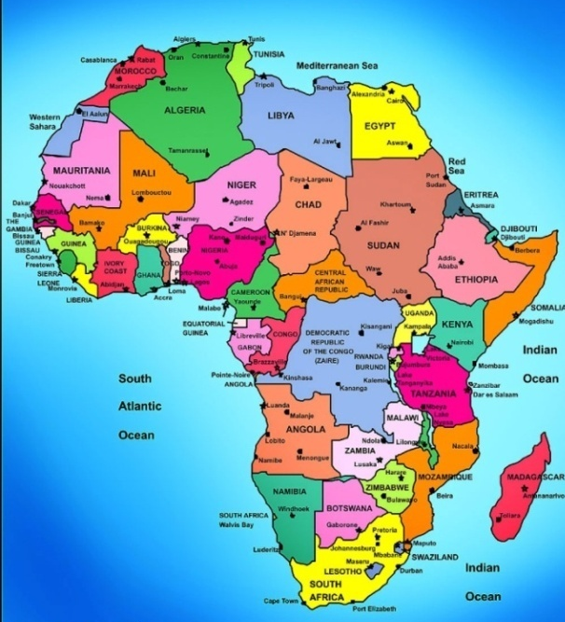
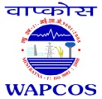
9th CII-EXIM BANK CONCLAVE
ON INDIA AFRICA PROJECT PARTNERSHIP
NEW DELHI, MARCH 2013
SEARCH FOR SUSTAINABLE POWER:
INDIA-AFRICA PARTNERSHIP
ISO 9001:2008
(A Govt. of India Undertaking- Ministry of Water Resources)
International Consultants in Water Resources, Power and Infrastructure
DR. R.K. GUPTA
Chairman Cum Managing Director

Slide 2
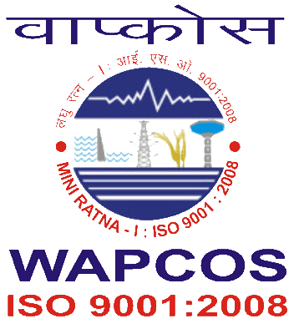
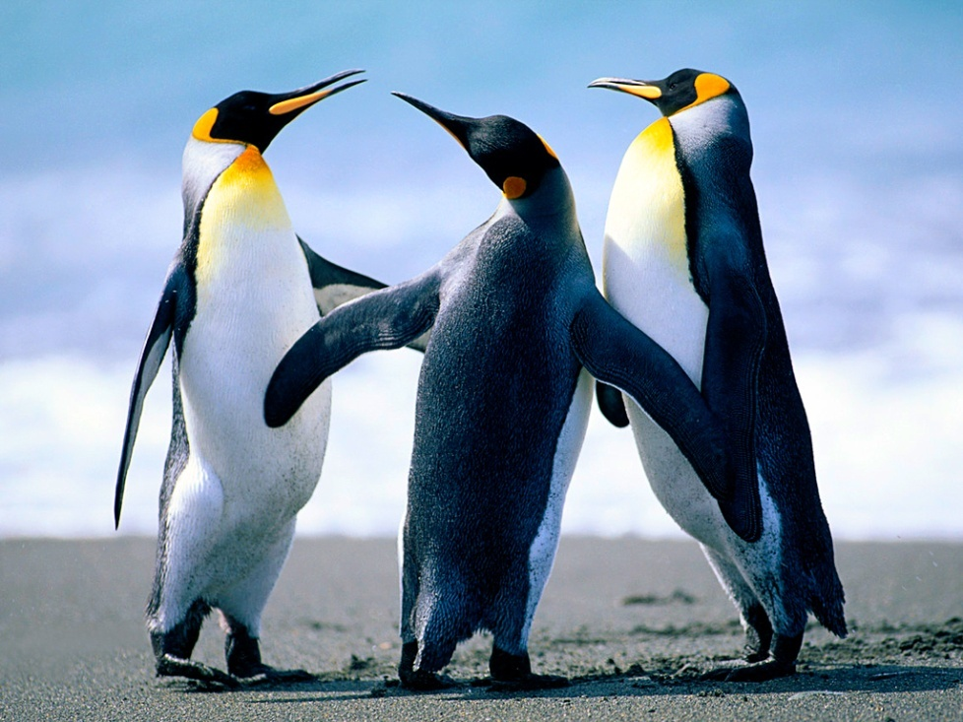
What is SUSTAINABLE DEVELOPMENT?
Development essentially is a process by which the existing potential is realized and become Apparent.
Sustainability in simple word means capacity to keep up and keep going for ever.
Hence the Sustainable development can best be described “Development which meets the need of the present without compromising the ability of future generations to meet their own needs”
2

Slide 3
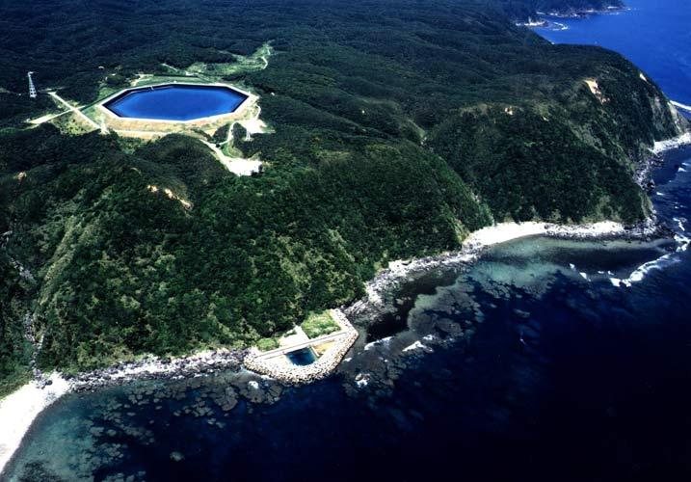
SUSTAINABLE POWER- NOT MW NUMBERS BUT IT SUPORTS LIFE
1 MW CAN TRANSLATE INTO
Lighting 1000 households
100 cottage Industries
Irrigating 900 Ha land
Production of 5000 MT food grains
Drinking water for 10,000 people
3

Slide 4
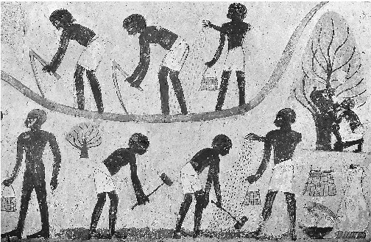
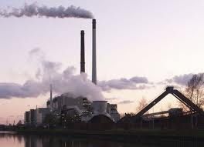
Evolution-Power Development
Mankind has been exploring various power means to meet their needs.
In the beginning - to meet Basic & Primary requirements.
Increased Population-increased power requirement
Demand met largely with fossil fuels .
Today Power is synonymous with growth and development.
4

Slide 5
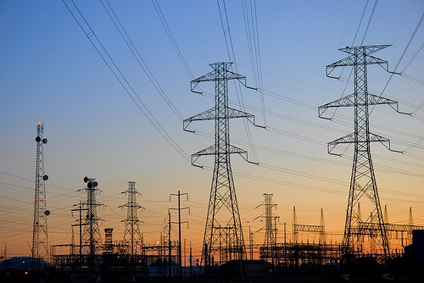
World Electricity Scenario-At a glance
TWh
TWh
Aaaaaaaaaa
aaaaaaaaaa
Africa’s Power contribution in World
5

Slide 6
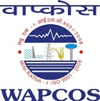
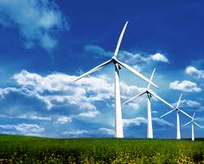
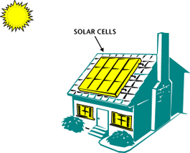
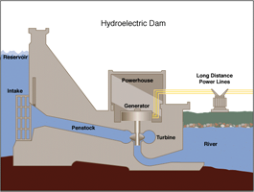
Need forAlternatives
Fossil fuel Power - finite , limited & depleting.
Power generation from fossil fuels-Emission of Green House Gases .
Adverse impact - Climate Change .
Fossil Fuel Power Model- Unsustainable
Search for alternatives -Renewable, Cleaner & MOST IMPORTANTLY SUSTAINABLE POWER
Hydro-Power, Solar, Wind – Green ,Clean and perpetual in Nature
HYDRO POWER – A GOOD ALTERNATIVE
Hydropower-Most Attractive, Sustainable, Technically proven and Affordable alternate.
6

Slide 7
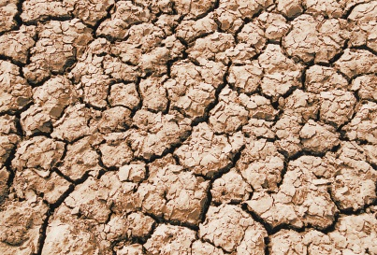
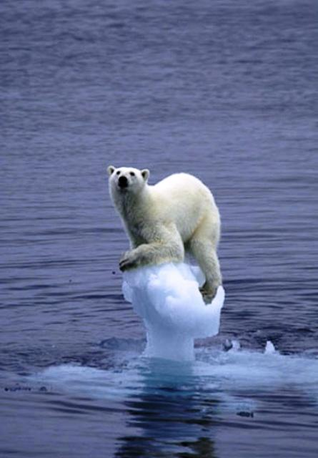
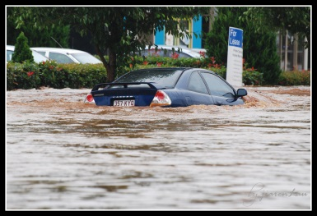
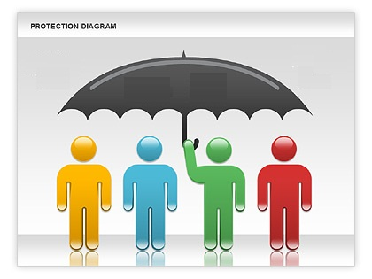
KEY ADVANATAGES OF HYDROPOWER
Perpetual in Nature
Affordable
Mitigates Climate change
Flood and Drought protection.
Supports biodiversity
Provides Peak Power
Large potential Available
Reduced Global Warming-Supports Water preservation
Flood
Drought
Climate Change
7

Slide 8
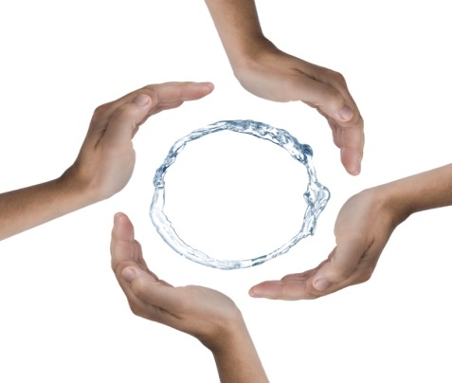
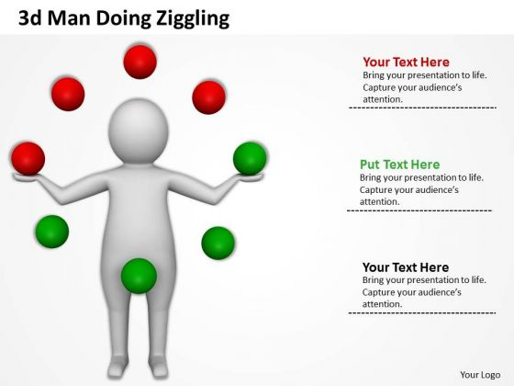
HYDROPOWER- SUPPORTS PRESERVATION OF WATER RESOURCES
Preservation of water Ensures basic needs such as:
Drinking water
Irrigation supplies
Ecological requirements
Food security, etc.
Continuous Water Availability along with Energy supply offers :
Source of livelihood
Furthering education/literacy
Sustainable power development
8

Slide 9
SCOPE OF HYDROPOWER GENERATION IN AFRICA
Hydropower Scenario – Africa exploits only 7% of its Hydro Potential
TECHNICAL POTENTIAL
ECONOMICAL POTENTIAL

Slide 10
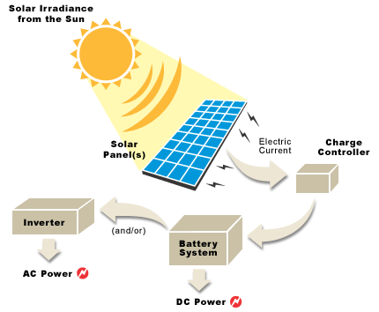
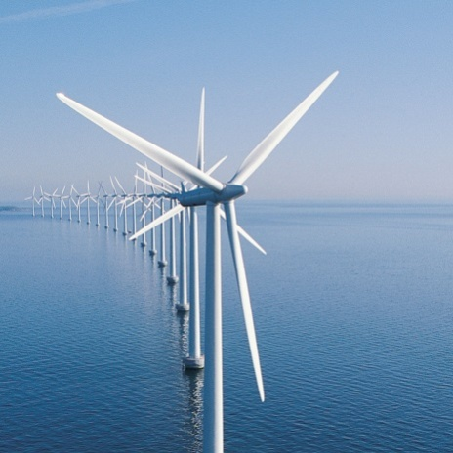
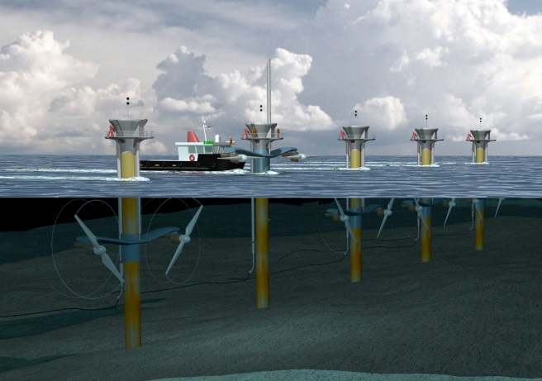
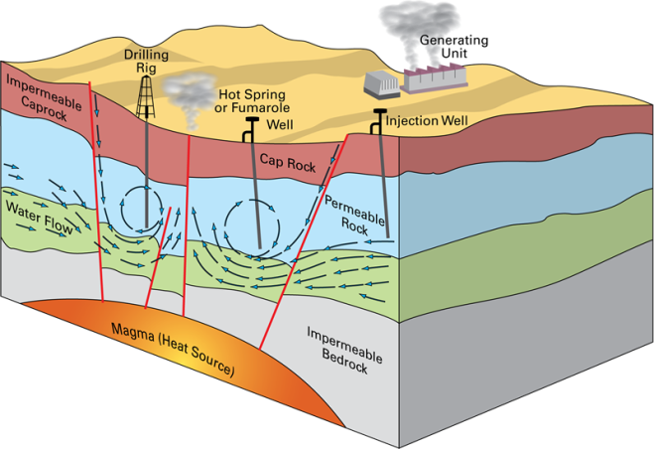
Opportunity for
Other Renewable sources
of Power in Africa
Solar Energy
Most countries receive 325 days per year bright sunlight.
Energy could be delivered, virtually anywhere without large scale grid level infrastructure
Wind & Tidal Energy
Long Coastline
Vastly underutilized as of now
Geothermal Energy
Vast potential in many East African countries
10

Slide 11
Challenges
PROJECT DEVEOLPEMENT GAPS - BIGGEST IMPEDEMENT TO DEVELOPMEMT
FINANCING IS AVAILABLE BUT BANKABLE PROJECTS ARE NOT AVAILABLE
EXPECTATIONS FROM THE DPRs
CONSULTANTS QUALIFICATIONS
Balancing private and public sector interests
Transparency and investor Confidence
Pursuit of sustainable economic and social benefits.
Global financing Options
Understanding of the Sector Dynamics
Experience in Emerging markets
Capability to provide State of the art technology, cost effective solutions.
On time Implementation
Willingness to go “THE EXTRA MILE”
11

Slide 12
Project Management
Contract Management
Construction Supervision
Quality Control
Construction Drawings
Tender Engineering
12

Slide 13
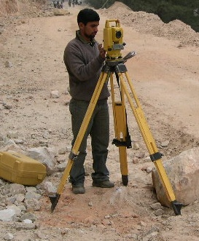
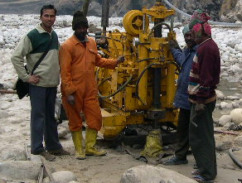
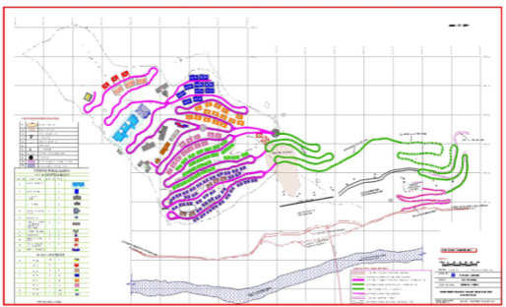
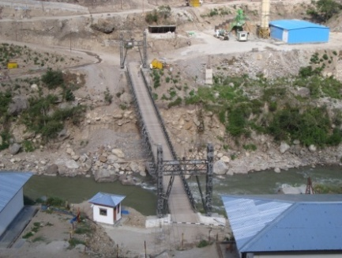
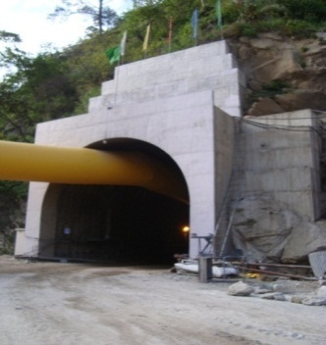
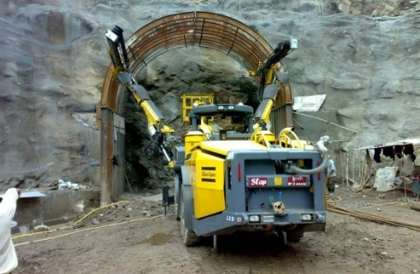
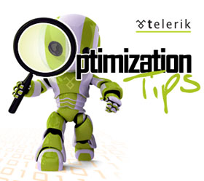
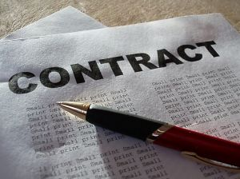
WAPCOS – the Design Engineering Consultant
WAPCOS render design engineering consultancy encompassing Infrastructure, Main Civil works & Hydro-mechanical works, the sphere of activities as follows:
Topographical surveys
Geological/ Geotechnical Investigations
Conceptualization & layout planning
Tender Engineering
Development of Infrastructure Works Including Roads, Bridges
Design Engineering
Technical Assistance during Construction
Optimization of Site specific
problems & solutions
Contract Management
13

Slide 14
14

Slide 15
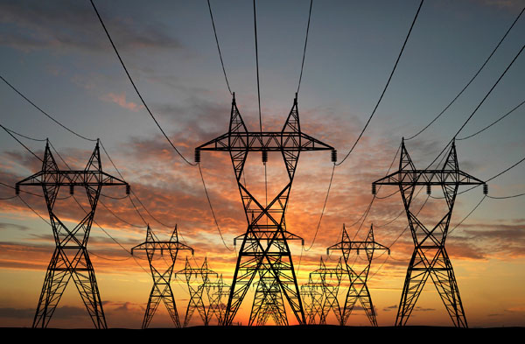
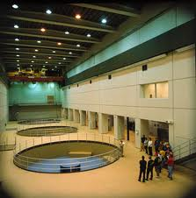
POWER SECTOR
Surveys & Investigation/Detailed Project Reports & Project Management Consultancy for
USP
Overseas
India
Over 43 Hydro Power Projects with an installed capacity of more than 8000 MW
7 Thermal Power Projects with an installed capacity of more than 11000 MW
47 Hydro Power Projects in 17 Countries with an installed capacity of more than 20,000 MW
8 Thermal Power Projects with an installed capacity of more than 2900 MW
17 Transmission Projects
15
15

Slide 16
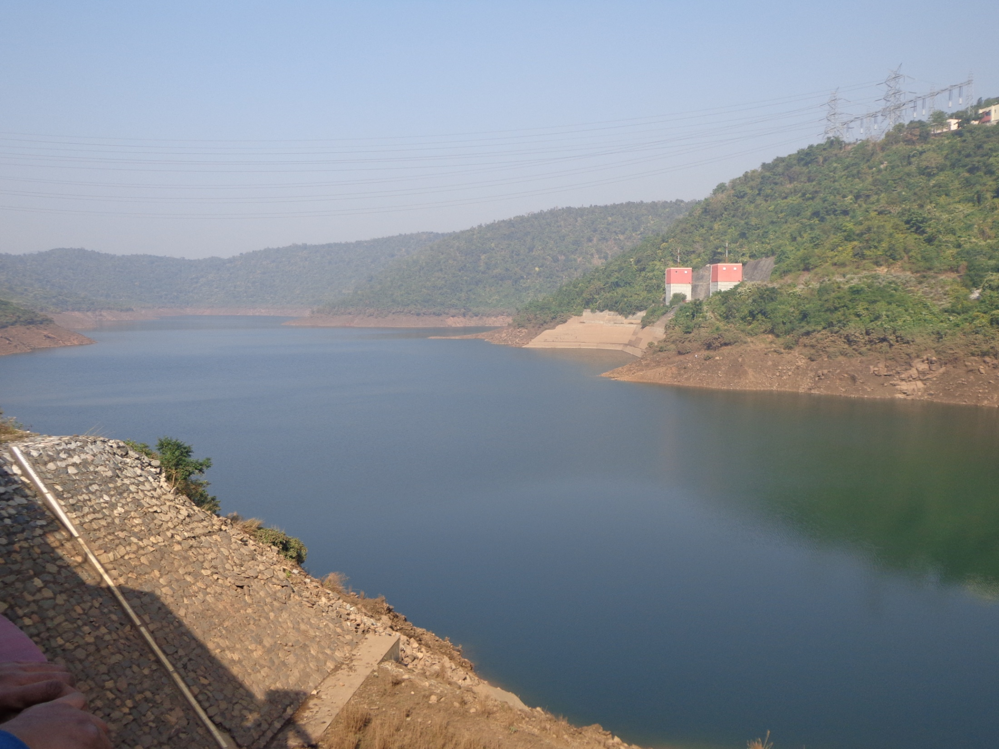
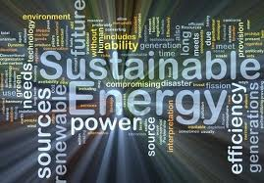
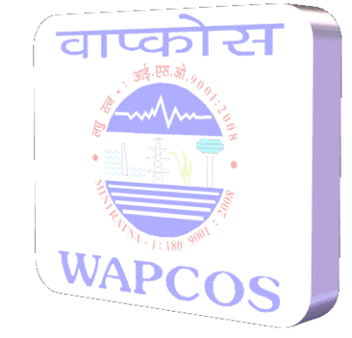
Sustainable power development model
Exciting Yet Challenging opportunities await in Africa
Time to Synergise capabilities of India & Africa
Ensuring Sustainable power development model
WAPCOS wish to render any assistance towards achieving the goal of
SUSTAINABLE HYDROPOWER DEVELOPMENT IN AFRICA
16

