Slide 1
RENOVATION, MODERNIZATION & UPRATING OF HYDRO POWER PLANTS
By
B.PODDAR

Slide 2
1. INTRODUCTION
A Hydro electric power scheme construction is normally associated with long life assets that comprise about 70 % of the cost structure
Civil assets are normally not subjected to the normal wear and tear in comparison to electrical components.
The life of civil assets are normally designed for 100 years whereas the remaining 30 % of electrical /mechanical assets are designed for 30 to 35 years

Slide 3
The life expectancy of a hydro power station mainly depends on
a) Service Conditions (Peaking, base load or so on)
b) Mechanical , thermal and electrical stress levels
c) Environmental conditions and
d) Maintenance Standards
Due to prolonged operation the capacity of generation is reduced and should be revived as early as possible.
Possibilities of up-rating must be explored while implementing renovation plans
While up-rating, limitations of water conductor system, water availability, structure stability etc also need to be thoroughly examined.

Slide 4
2. REASONS FOR R & M
The R & M is aimed at over coming problems due to generic defects, design deficiency, ageing, obsolescence of equipment/component and non availability of spares, in-efficiency of generating unit and safety requirements etc.
The main objective of R&M is to make the operating units modified/augmented with latest technology with a view of improving their performance in terms of efficiency, output, reliability, reduction in maintenance requirement and ease of maintenance
R & M is not a substitute for regular annual or capital maintenance

Slide 5
The main reasons for R & M can be summarized as given below
The cost of new hydro plants or their complete replacement is very high.
Obsolescence and non availability of spares.
Old generator windings are generally equipped with class B insulation which deteriorates resulting in de rating and forced outages.
De rating of the unit output due to wear and tear
Increase in forced outages due to deterioration in the condition of wearable parts, unit and station auxiliaries, instruments, protective relays and control equipment.

Slide 6
Change in the operating criteria of the power plant in the system i.e., change in plant load factor requiring additional capacity, requirement of higher excitation system due to larger grid.
Mechanical flywheel type governor for turbine control is now obsolete and not suitable for modern system for interconnected large grids for speed control and load sharing.
Old shaft mounted excitation system is very slow and requires to be replaced by modern static excitation system or shaft mounted brush less system for small generators
Control and protection system concept and equipment have changed. Modernization is required to change control and protection equipment.

Slide 7
3. UP RATING
The definition of up rating is the replacement or improvement of components required to increase the unit KVA output.
Before considering up rating, all components between the generator terminals and the unit transformer high-voltage bushings and also the HV switchyard, should be investigated.
Prior to a generator up rating evaluation, it is necessary to determine whether or not the turbine rating can be increased with changed hydraulic conditions and improved design.
This may require either a rebuilt or a replacement of turbine runner.

Slide 8
Up rating potential of a project depends on:
The age of the equipment;
Optimal utilization of inherent design margins
The generator design
The respective turbine up rating capabilities;
The possible power transformer limitations
Before evaluating an unit for increased output, present site characteristics should be compared with the original conditions. It is advisable to redefine present operating conditions to establish the following:
Do original hydraulic conditions (planned water flow and/or storage and head applicable to a base year) coincide with present day conditions?

Slide 9
Have system requirements changed and low value off-peak energy generation to high value peak energy generation possible?
Can peak loads be generated without exceeding permissible flood and/or discharge fluctuations?
Do current penstocks and draft tubes or tailrace tunnels allow for increased flow?
Is it possible, or even necessary, to increase the impounding height to improve flood protection for an increase in turbine output?
Have system requirements changed to allow for revisions in generator design (such as power factor, reactance, and so on)
The effort required to produce an up rating study is greater than for an upgrading because of the additional investigations required.

Slide 10
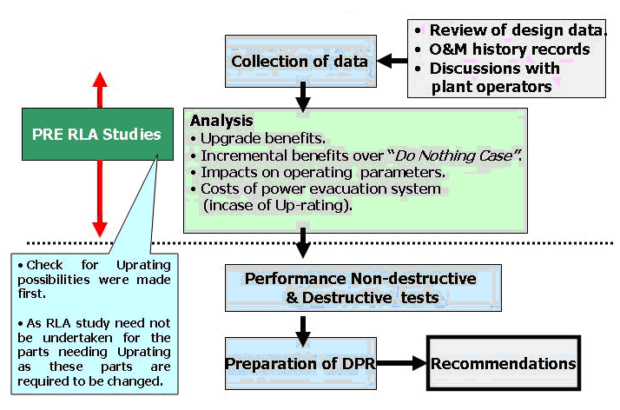
4. PLANNING AND IMPLEMENTATION METHODOLOGY
The planning and Implementation methodology is highlighted in the figures 1 & 2 shown below.
FIGURE 1 PLANNING FOR R, M & U

Slide 11
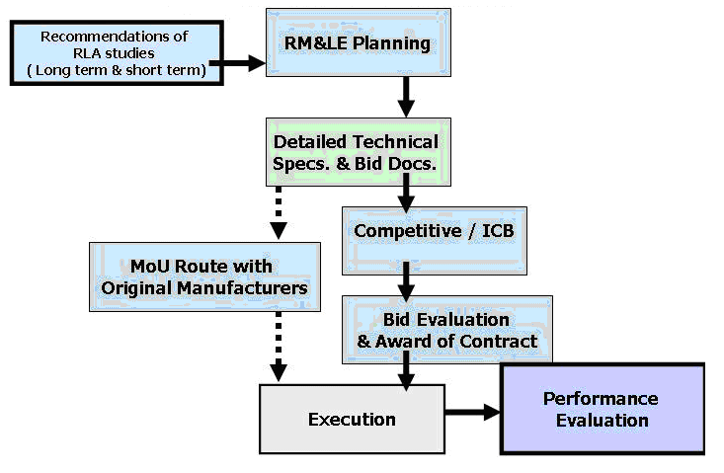
Figure 2 IMPLEMENTATION METHODOLOGY FOR R, M & U

Slide 12
5. ECONOMY OF UPRATING
Generator up rating measures do not require structural alterations to the power plant (powerhouse, dam, and so on).
Increased output can thus be achieved for a fraction of the cost of building a new power plant.

Slide 13
6. PROJECTS IN AFRICA WHICH ARE MORE THAN 20 YEARS OLD MAY BE CONSIDERED FOR R,M & U (HAVING INSTALLED CAPACITY MORE THAN 25MW )
S. No | Country | Hydro Electric Station | Capacity | Year Completed
1 | Cameroon | Edea Power Station | 204 MW | 1953
2 | Cameroon | Song Loulou Power Station | 384 MW | 1981 & 1988
3 | Cameroon | Lagdo Power plant | 72 MW | 1982
4 | Egypt | Aswan Power Station | 2100 MW | 1970
5 | Ethiopia | Koka Power Station | 43 MW | 1960
6 | Ethiopia | Awash II Power Station | 32 MW | 1966
7 | Ethiopia | Awash III Power Station | 32 MW | 1971

Slide 14
S. No | Country | Hydro Electric Station | Capacity | Year Completed
8 | Ethiopia | Fincha Power Station | 134 MW | 1973
9 | Ethiopia | Melka Wakena Power Station | 150 MW | 1989
10 | Ghana | Akosombo Power Station | 1020 MW | 1965
11 | Ghana | Kpong Power Station | 160 MW | 1982
12 | Ivory Coast | Kossou Power Station | 176 MW | 1973
13 | Ivory Coast | Taabo Power Station | 210 MW | 1979
14 | Ivory Coast | Buyo Power Station | 165 MW | 1980
15 | Kenya | Kiambere Power Station | 168 MW | 1988

Slide 15
S. No | Country | Hydro Electric Station | Capacity | Year Completed
16 | Kenya | Kindaruma Power Station | 72 MW | 1968
17 | Kenya | Masinga Power Station | 40 MW | 1981
18 | Kenya | Kamburu Power Station | 100 MW | 1974
19 | Kenya | Turkwel Power Station | 106 MW | 1991
20 | Liberia | Mount Coffee Power Station | 64 MW | 1966
21 | Malawi | Nkhula A Power Station | 24 MW | 1966
22 | Malawi | Nkhula B Power Station | 120 MW | 1980, 1986 & 1992
23 | Mozambique | Cahora Bassa Power Station | 2075 MW | 1975
24 | Namibia | Ruacana Power Station | 240 MW | 1978

Slide 16
S. No | Country | Hydro Electric Station | Capacity | Year Completed
25 | Nigeria | Kainji Power Station | 800 MW | 1968
26 | Nigeria | Jebba Power Station | 540 MW | 1985
27 | Nigeria | Shiroro Power Station | 600 MW | 1990
28 | South Africa | Drakensberg Pumped storage | 1000 MW | 1981
29 | South Africa | Gariep Dam | 360 MW | 1971
30 | South Africa | Palmiet Pumped Storage | 400 MW | 1988
31 | Sudan | Jabal Awlia Power Station | 35 MW | 1937
32 | Tanzania | Mtera Power Station | 80 MW | 1979

Slide 17
S. No | Country | Hydro Electric Station | Capacity | Year Completed
33 | Tanzania | Kidatu Power Station | 204 MW | 1976
34 | Uganda | Nalubaalw Power Station | 180 MW | 1954
35 | Zimbabwe | Kariba Power Station | 1320 MW | 1977

Slide 18
7. CONCLUSION
Considerable improvements in output, efficiency, reliability and availability are convincing factors for an upgrading or uprating project, but sometimes lack of funds or budget constraints become obstacles to short-term implementation.
Instead of prolonged operation of ageing equipment with the associated high maintenance costs, the funding which such maintenance would require over several years can instead be allocated to performing a major overhaul at an earlier time.
If a refurbishment project includes an up rating, this will usually lead to increased output revenue, and if the payback period is short, the rehabilitation should be initiated at the earliest opportunity.

Slide 19
Thank You…

